Slide 1
CHAPTER 1. MAMMALIAN HISTOLOGY

Slide 2
In this Chapter we will discuss on ..
What are the objectives to study the basic histology ?
What are the desired outcomes ?
What is histology?
Histological structures of following organs are included in our syllabus
1. Skin – It includes
a. V.S. of Skin and associated structures
2. Digestive system and associated glands
V.S. of tooth
T. S. of tongue
T.S. of Stomach
T.S. of small intestine
T.S. of large intestine
T.S. of Salivary gland
T.S. of Liver

Slide 3
What are the objectives to study the basic histology ?
To familiarize the learner with the cellular architecture of the various organs in the body.
To make the learner understand the need and importance of different types of tissues in the vital organs and their functions
What are the desired outcomes ?
Learner would appreciate the well planned organization of tissues and cells in the organ system
What is histology?
is the branch of biology which studies the microscopic anatomy of biological tissues.

Slide 4
What is histology?
It is the branch of biology which studies the microscopic anatomy of biological tissues
What is anatomy ?
Anatomy (Greek anatomē, 'dissection') is the branch of biology concerned with the study of the structure of organisms and their parts
What is tissue ?
A tissue is a group of cells, in close proximity, organized to perform one or more specific functions. There are four basic tissue types defined by their morphology and function: epithelial tissue, connective tissue, muscle tissue, and nervous tissue.

Slide 5
1.1. Vertical Section of the Skin
In mammals, skin is the largest organ. Skin and associated structures form the integumentary system.
FUNCTIONS OF SKIN
It protects the body from external environment, chemicals and pathogens.
It helps to regulate the body temperature.
It is used in the communication with other organisms.
Skin provides nourishment to young ones.
SKIN LAYERS AND ASSOCATED STRCUTURES
There are three layers viz. Epidermis, Dermis and Hypodermis.
The associated strictures are
Hair, Sweat gland, Sebaceous gland, Mechanoreceptors, Pacinian corpuscles , Meissener’s Corpuscles, Merkel’s disc, Ruffini endings and free nerve endings

Slide 6
1.1. Vertical Section of the Skin
HISTOLOGY OF SKIN
On the basis of thickness, there are two types
Skin
Thin Skin
Has four layers of cells in the Epidermis
Thick Skin
has five layers of cells in the epidermis. Found only on palms of the hand and soles of the feet.

Slide 7
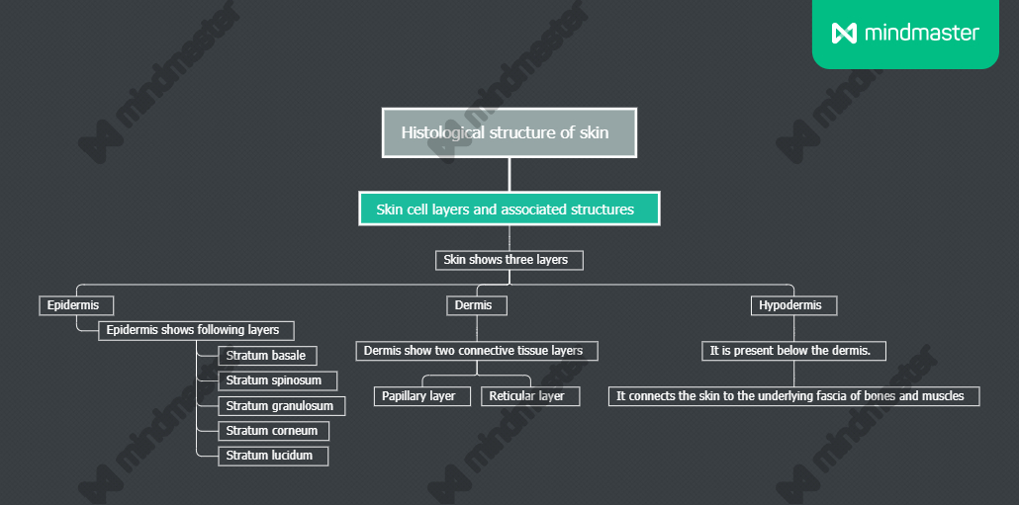

Slide 8
1. Stratum basale (Stratum germinativum)
It is the deepest epidermal layer.
It is primarily made up of basal cells.
Cells are cuboidal in shaped stem cell which is precursor of the keratinocytes of the epidermis.
The other two types of cells are found in this layer are Merkel Cell and Melanocyte.
2. Stratum spinosum
It is spiny in appearance.
The desmosomes present on the cells interlock them and strengthen the bond between the cells.
It is composed of 8 to 10 layers of Keratinocytes.
Dendritic cells i.e. Langerhans cells function as macrophage.

Slide 9
3. Stratum granulosum
It has grainy appearance due to further changes in the keratinocytes.
Cells are flat and have thick membranes and they generate large amount of keratin which accumulates as lamellar granules within cells.
The two protiens viz. keratin and keratohyalin. These two proteins make up the bulk of the keratinocyte massin the stratum granulosum and giving the layer its grainy appearance.

Slide 10
4. Stratum lucidum
It is smooth, transluscent layer of epidermis.
It is located just above the stratum granulosum and below stratum corneum.
It is only found in the thick skin of the palms, soles and digits.
Keratinocytes in the stratum lucidum are dead and flattened.
5. Stratum Corneum
Most superficial layer of epidermis. 15 to 3o layers of skin.
It is dry and dead layer which prevents penetration of microbes and dehydration of underlying tissues. Cells Shade periodically and entire layer is replaced in 4 weeks.

Slide 11
Dermis
This layer is the core of integumentory system. It is distinct from epidermis and hypodermis. It contains blood vessels, nerves, hair follicles, sweat glands. Dermal papilla is present in superficial portion of dermis. It is a finger like projection or fold.
Dermal papilla connects epidermis and dermis. The dermis is made up of two layers of connective tissue that compose an interconnected mesh of elastin and collagen fibres, produced by fibroblasts.
Papillary layer is made up of loose, areolar connective tissue.
Reticular layer is the present below the papillary layer.
Hypodermis
It is present below the dermis. It serves to connect the skin to the underlying fascia of the bones and muscles.
Hair is unique mammalian feature. The developing epidermis invigilates into dermis to form a follicle.

Slide 12
Skin glands :
In the skin there are two kinds of skin glands
Sweat glands : Apocrine sweat gland and Merocrine sweat gland
Sebaceous glands: Secrete senum
Mechanoreceptors in the skin :
These are primary nerve neurons or nerve endings that respond to mechanical stimuli.
Pascinian Corpuscles : Pressure receptors
Meissner’s Corpuscles : Responsible for sensitivity to light touch.
Merkel’s Discs: Sensitive to touch.
Ruffini Endings- Sensitive to skin stretch and contributes to kinesthetic sense of and control finger position and movement.
Free nerve endings: These are unencapsulated and have no complex sensory structures. The nerve endings functions as thermoreceptors, cutaneous mechanoreceptors and nociceptors. Hence they express polymodality.

